Slide 1
MINT – Forth’s Kid Brother?
Forth 2020 Saturday 10th May 2025 Ken Boak

Slide 2
In this talk, I will present the following:
Introduction to MINT, how it evolved, similarities and differences to Forth.
Early implementations: Txtzyme (2011) by Ward Cunningham, SIMPL (Ken Boak 2013) and STABLE (2016) by Sandor Schneider
The first real MINT - a Z80 implementation (for the TEC-1 and RC2014),. by John Hardy, Craig Jones and myself.
Other implementations: MINT6502 and CMINT
New developments:- eMINT (inspired by C.H.Ting's eForth model).
Applications.

Slide 3
Introduction to MINT
MINT comes from the portmanteau of Minimal INTerpreter.
It is an interpreted, stack-based, integer arithmetic, RPN language.
It uses both a data stack and a return stack.
It uses printable ascii characters as words, variables and operations.
Many of the symbols and syntax used will be familiar to Forth Users.
There is no dictionary – all words are single characters in a jump table.
It provides a subset of Forth – intended for lightweight implementation.
The source code is very compact, with good degree of human readability.
Source code can be cut and pasted with text editor and serial terminal.
The MINT interpreter occupies typically less that 2k bytes (on Z80).

Slide 4
The Evolution of MINT – a little history:- Part 1.
It started with TinyForth by T. Nakagawa in 2004, a cut down Forth similar in philosophy to TinyBASIC.
In 2011, Ward Cunningham wrote Txtzyme a tiny interpreter to run on Arduino
It had just 13 commands, one variable x, no arithmetic, no stacks, no : ; defs.
It provided an immediate interpreted environment to interact with the I/O.
I came across Txtzyme in 2013, creating SIMPL on Arduino and MSP430.
SIMPL - Serial Interpreted Minimal Programming Language.
This added maths, User Defined functions (colon defs) and more variables.
I used it for exercising motion control and force sensor instruments.
Another application was a simple memory dump screen/editor for MSP430.
I referred to as a ”hardware bring-up tool” for initial testing of new hardware.

Slide 5
The Evolution of MINT – a little history:- Part 2.
SIMPL was ported to STM32 MCU and other Arduino compatible dev-boards.
Still lacking stacks, it could perform loops, sequences and conditional code.
User definitions could be chained together to form new functions.
I ported it to MSP430 assembly language, having read of Ting’s eForth model.
SIMPL development was paused due to other work commitments.
In 2019, I began thinking about using SIMPL as “assembly language” for a VM.
I needed to find a simple solution to implementing the missing stacks.
I had watched John Hardy’s presentations on Forth for Z80.
This encouraged me to write SIMPL in Z80 assembly language for my RC2014

Slide 6
The Evolution of MINT – a little history:- Part 3.
In lockdown of Spring 2021, I found out about STABLE by Sandor Schneider.
STABLE is a minimal interpreted language, written in 50 lines of compact C.
Most importantly, this gave me formal implementations of the stacks, in C.
At the same time, John, Sandor and I founded “Minimalist Computing” on FB.
John and I discussed an implementation of such an interpreter on the Z80.
John saw it as an alternative to assembly language on the TEC-1 computer.
The TEC-1 was a small Z80 machine with hex-keypad and 7-segment LEDs.
It was limited to just a 2K ROM, and used bit-banging serial routines.
It was developed by John in the early 80s for “Talking Electronics” magazine.
The TEC-1 is still well known to enthusiasts in Australia.
I worked on the inner interpreter and arithmetic routines, John handled the stack handling and arrays, and Craig Jones provided the bit-banging serial I/O code.
MINT for Z80 was first demonstrated at Christmas 2021 on both TEC1 and RC2014.

Slide 7
Other implementations: MINT6502 and CMINT
Having successfully proven the implementation in under 2Kbytes on the Z80, I wanted to show that it could be applied to other “classic” 8-bit CPUs.
A version MINT6502 was written by Alvaro G S Barcellos in 6502 assembly.
A generic version was written in C, CMINT, by Jason C.J. Tay.
This has been ported to a wide range of MCUs, including ATmega328, 8052, STM32F743.
The next slide shows comparative benchmarks for CMINT running on various MCUs.

Slide 8
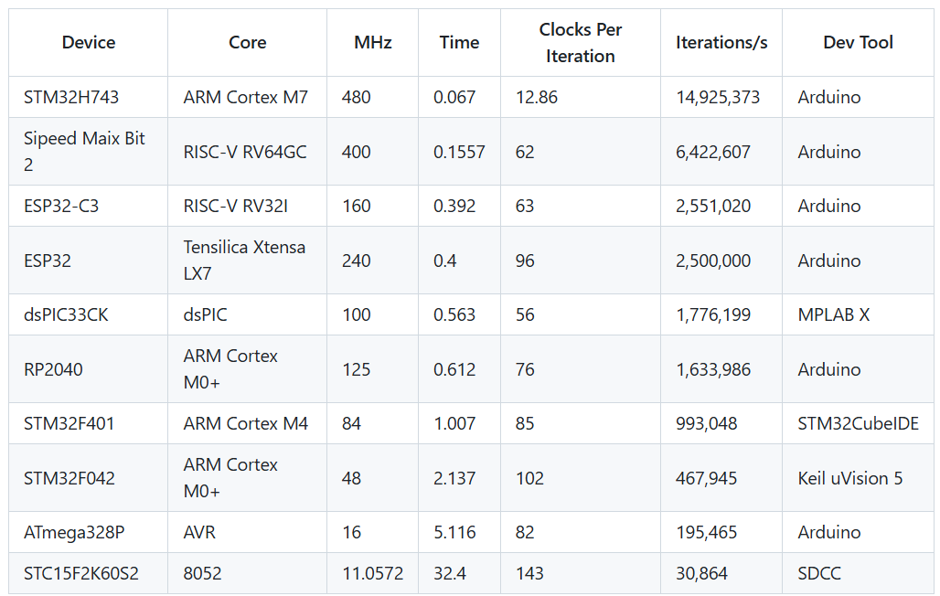
CMINT Benchmarks for 1,000,000 empty loops – Jason C.J Tay.

Slide 9
New developments:- eMINT inspired by C.H.Ting’s eForth model.
Ting’s model reduces the Forth inner interpreter to just 31 primitive functions.
These primitives are equivalent to the instruction set of a virtual machine.
A full Forth can be built using just these 31 primitives, each written in minimal, target specific assembly language.
I noticed that Ting’s choice of primitives are very similar to those of MINT.
Using the eForth primitives to define MINT, we can use MINT to build a Forth.
But a MINT primitive is defined by 1 character, not a 16-bit jump address.
Thus, an eForth build could be implemented in fewer bytes.
John Hardy had already written some of the more advanced MINT functions in inline MINT code – thus proving the concept.
I see eMINT as a compact means provide portable code for a variety of CPUs
Conceptually, eMINT is eForth’s kid brother.

Slide 10
Applications and Future Work
MINT has acquired a small, dedicated following within the TEC-1 Community.
Some of you will know of my passion for “Minimalist Computing”. I am slowly working towards a CPU design in 74HCxx logic or FPGA that executes MINT as its native assembly language. Inspired by James Bowman’s J1 Forth CPU.
MINT has a very limited symbol set. Using Python or similar, a cross assembler could be developed to automate the build of MINT for many MCUs
Python scripts could not only automate the assembly of MINT, but decompress/disassemble it to less terse words and convert a high level language program to MINT primitives.

Slide 11
Links and Resources
Tytzyme – Ward Cunningham https://github.com/WardCunningham/Txtzyme
TinyForth - T. Nakagawa (Japanese – use Google translate) - http://middleriver.chagasi.com/electronics/tforth.html
SIMPL - https://github.com/monsonite/SIMPL
STABLE - https://w3group.de/stable.html
MINT (Z80) - https://github.com/orgMINT
MINT (6502) - https://github.com/agsb/6502.MINT
CMINT - https://github.com/trozodejamon/CMINT
MINT Computing - https://www.facebook.com/groups/278238447530031
Minimalist Computing https://www.facebook.com/groups/minimalistcomputing
Suite-16 - https://hackaday.io/project/168025-suite-16

